Slide 1



ALVAS INSTITUTE OF ENGINEERING AND TECHNOLOGY MIJAR,MOODBIDRI
VOICE CONTROLLED HOME AUTOMATION
USING ARDUINO
Guide:
Dr. Dattathreya Presented By:
(Senior Professor ,A.I.E.T) 4AL19EC003-ABDUL RASHEED
4AL19EC007-ABHISHEK NAIK
4AL19EC009-ABHISHEK M.O
4AL19EC020-ASHISH.SHETTY

Slide 2
CONTENTS
INTRODUCTION
PROBLEM STATEMENT
OBJECTIVE
LITERATURE SURVEY
BLOCK DIAGRAM
SYSTEM FLOWCHART
ADVANTAGES
APPLICATIONS
REFERENCES

Slide 3
INTRODUCTION
Voice control allows the user to activate or control a wide range of home automation and AV devices simply using their voice, as opposed to from one point to another point .
In general, voice control is the process of captivating the verbal word by means of an input to a computer database. The voice control also known as a category of computer science that related with designing computer systems that can recognize spoken words.
Voice control is very useful especially in current situation where smartphone users are the majority in India . In 2020, the penetration rate of smartphone in India reached 54 percent and was estimated to reach 96 percent in 2040, more than doubled from financial year 2016, when only around 23 percent of the total population were using smartphone.

Slide 4
PROBLEM STATEMENT
In daily practice, when people want to turn on or turn off their home appliances, they have to walk to their appliances to switch on or off mechanically. The following section shows problems identified that can overcome using voice control automated system
Busy schedules and hectic lifestyle
Disability or difficult to walk

Slide 5

Objective
Design control system for home
appliances using voice.
Build a simple interface for Android application

Slide 6
Literature Survey
Sairam Pal [1] have proposed a Voice Controlled Smart Home Automation System. This system is designed by using three main components, first is microcontroller Arduino Uno, second is Bluetooth module HC-05 and third is mechanical relay. Firstly user gives the command to microcontroller by using speech recognition system of smartphone and system software application via Bluetooth module HC-05. The microcontroller acts accordingly to the command give user and control the functionality of mechanical relay.
Arham Surve [2] have proposed Voice Controlled Smart Home Automation System Using VR 2.0 ,ATMEGA 320 and ZigBee. The prototype developed can control electrical devices in a home or an office. The system implements voice recognition using Easy VR 2.0 shield. Wireless communication is established using ZigBee RF modules because of their efficiency and low power consumption.
H.Kanma [3] also proposes a home automation system using Bluetooth that can be accessed remotely through GPRS.The researcher uses a cellphone equipped with Bluetooth connectivity .Home devices are fitted with Bluetooth communication adapters so that they can communicate with the host controller via Bluetooth.

Slide 7
Literature Survey
[4] Bluetooth based home automation system using cell phones: In Bluetooth based home automation system the home appliances are connected to the Arduino BT board at input output ports using relay. The program of Arduino BT board is based on high level interactive C language of microcontrollers.
[5] Zigbee-based home automation system using cell phones:To monitor and control the home appliances the system is designed and implemented using Zigbee. The device performance is record and store by network coordinators.

Slide 8
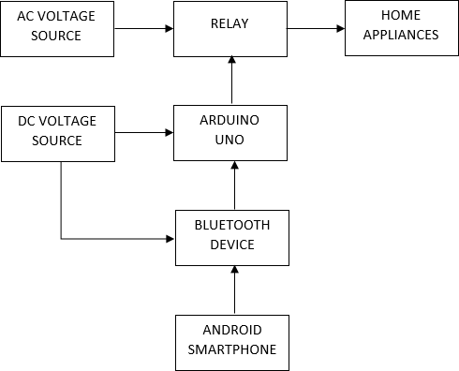
BLOCK DIAGRAM

Slide 9
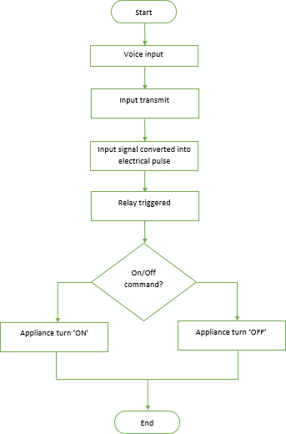
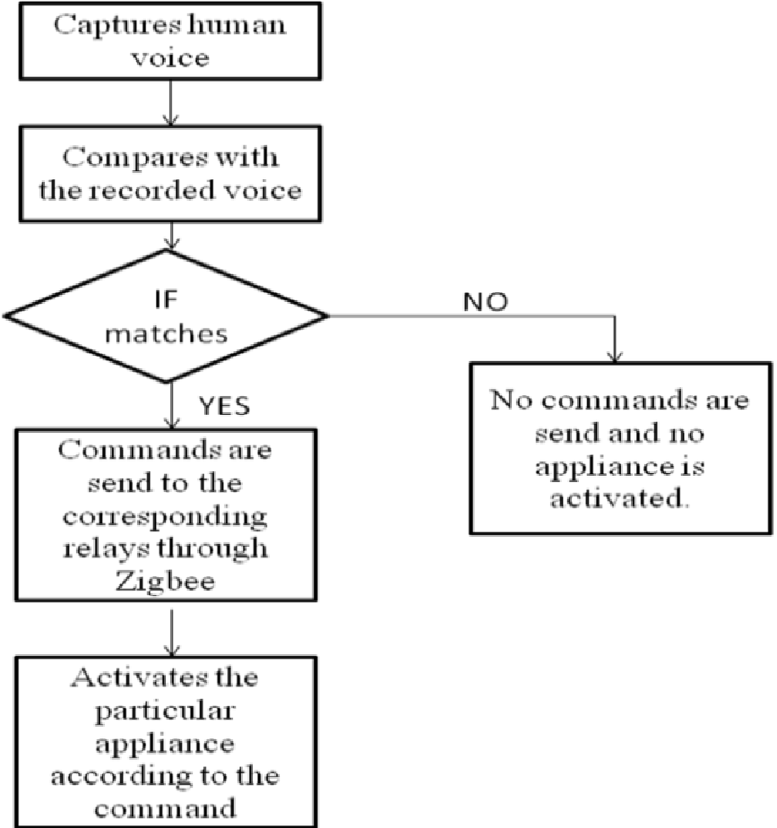
SYSTEM FLOWCHART
Bluetooth

Slide 10
Advantages
Managing all the home devices from one place
Multiple devices/appliances can be controlled using one Android device
We can customize modes of appliance
The Internet is not required for this project

Slide 11
Applications
Home automation using voice control can help disabled persons use appliances with ease
It can also be used in Industries
Further, the project can be expanded by adding different sensors (light, smoke, etc.)

Slide 12
References
[1] Arham Surve , Roshan Kankal ,“Voice Controlled Smart Home System “ Internation Journal of Electrical, Electronics and Data Communication ISSN:2320-2084 Volume-3,Issue-4,April-2015.
[2] Sairam Pal, Ashish Chauhan,” Voice Controlled Smart Home System”, International Journal of Recent Technology and Engineering(IJRTE) ISSN: 2277-2878,Volume-8 Issue-3,September 2019
[3]Kim Baraka, “Smart Power Management System For Home Appliances And Wellness Based On Wireless Sensors Network And Mobile Technology,” in XVIII AISEM Annual Conference, 2015.

Slide 13
[4] Yadnya Adhiya, Shriya Ghuge, H.D Gadade “A survey on home automation system using IOT” IJRITCC Volume 5 Issues March 17 Volume 5 Issue 3.
[5] Kim Baraka, Marc Ghobril, Sami Malek, RouwaidaKanj, AymanKayssi “Low cost Arduino/Android-based Energy-Efficient Home Automation System with Smart Task Scheduling”, 2013 Fifth International Conference on Computational Intelligence, Communication Systems and Networks.

Slide 14
THANK YOU

